Slide 1
METRICS IN MACHINE LEARNING
N.Mohan Prabhu

Slide 2
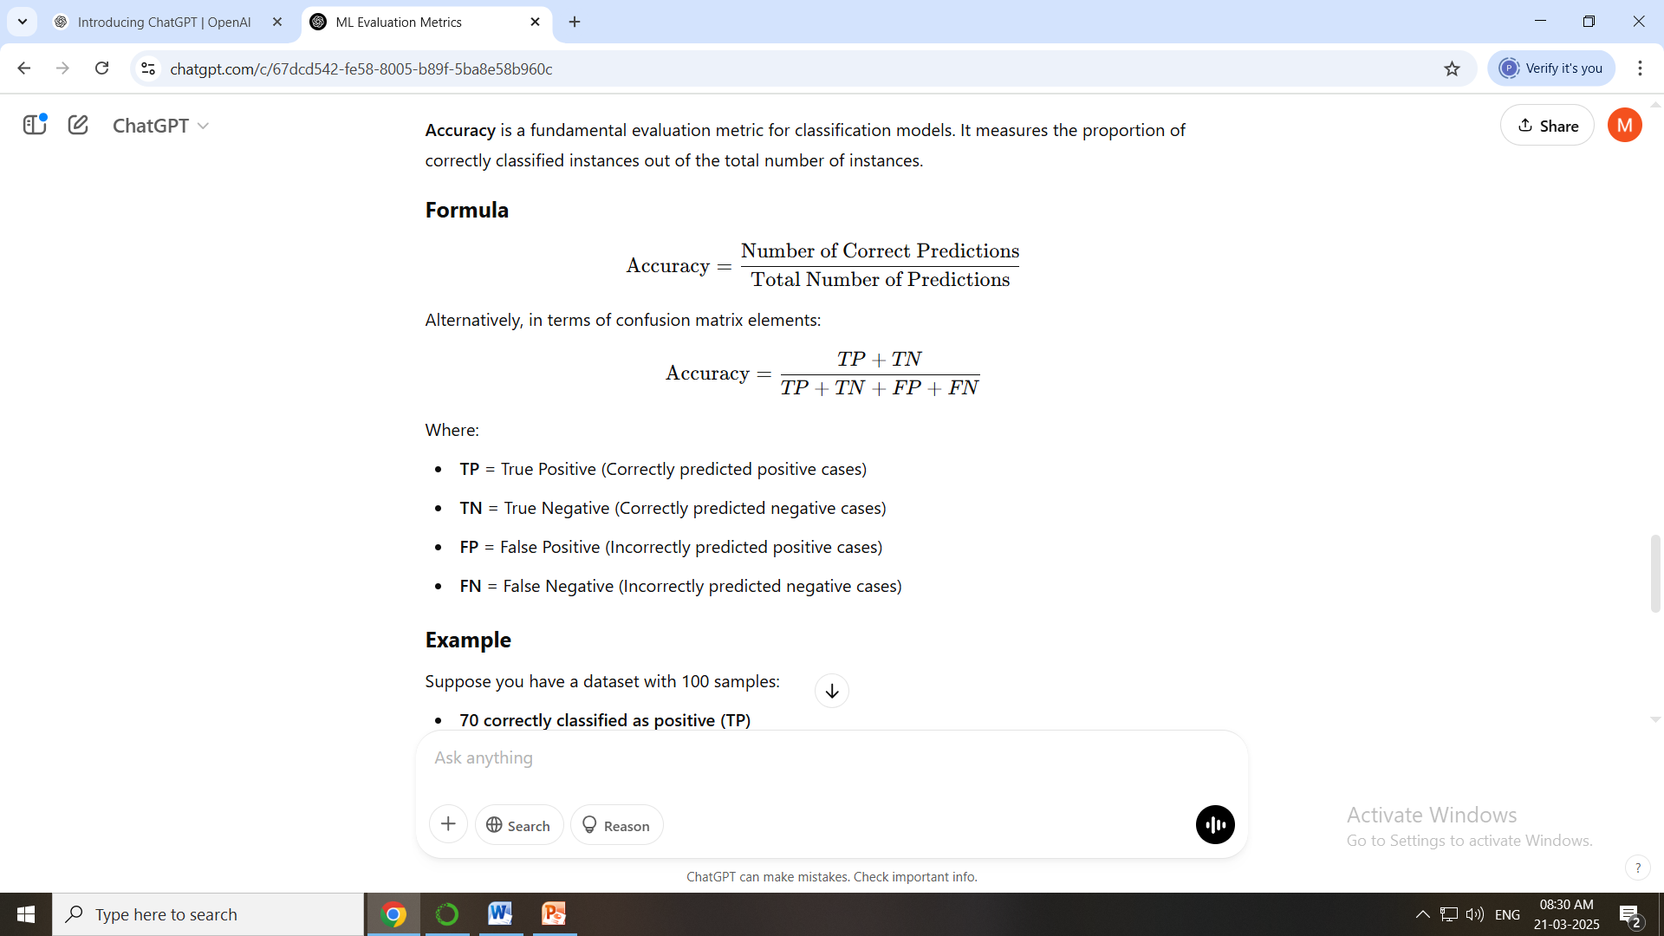
Classification Metrics
Accuracy-It measures the proportion of correctly classified instances out of the total number of instances.

Slide 3
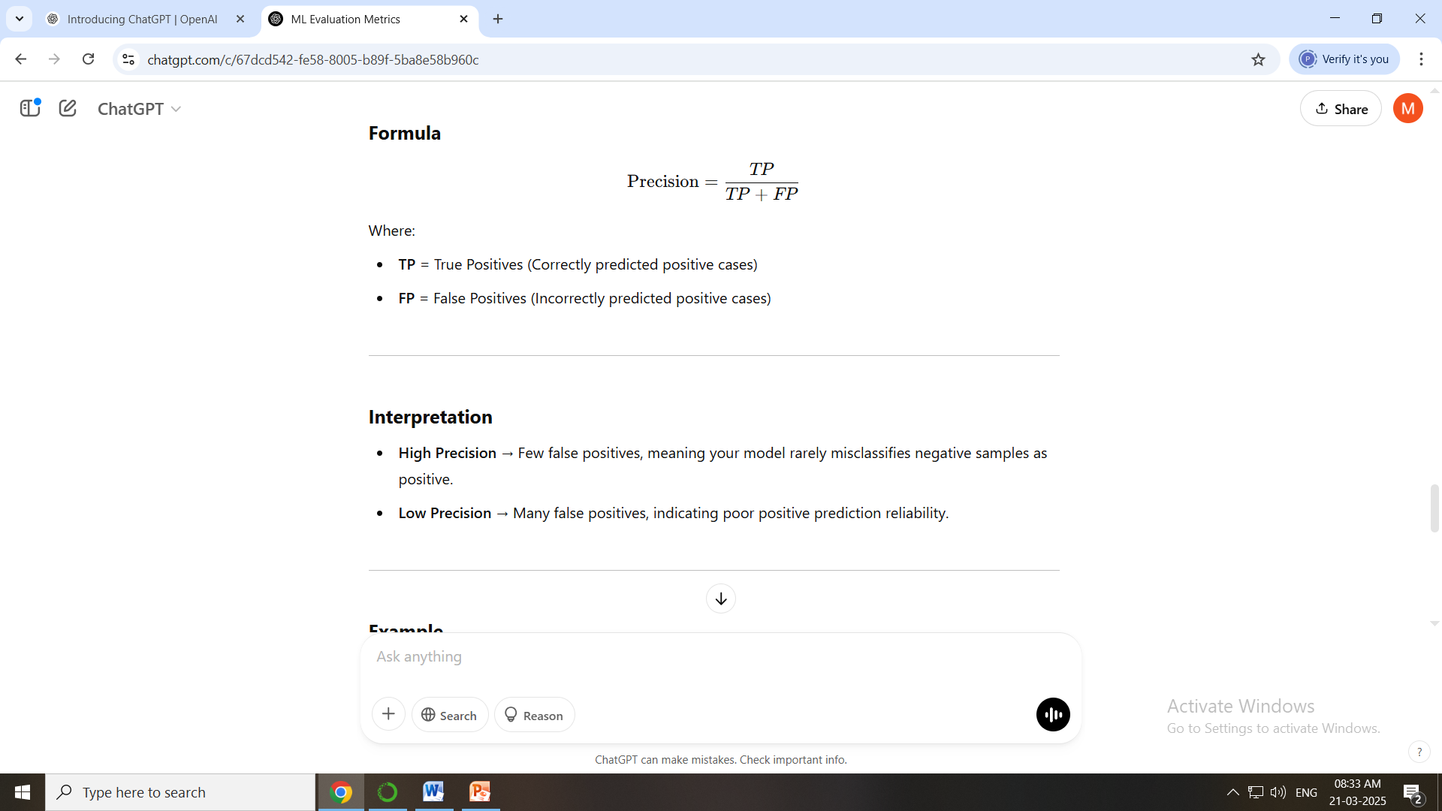
Precision (Positive Predictive Value)
Precision is a classification metric that measures the proportion of true positive predictions among all instances predicted as positive. It evaluates how accurate the model is when it predicts the positive class.

Slide 4
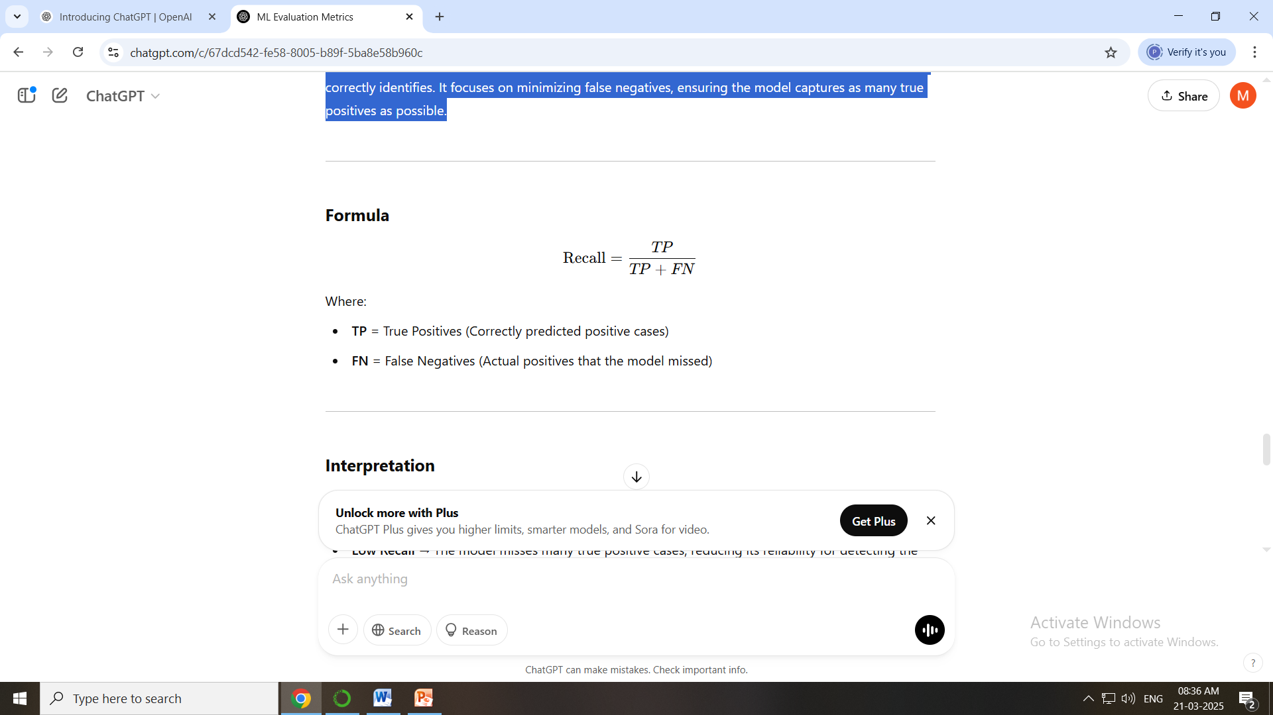
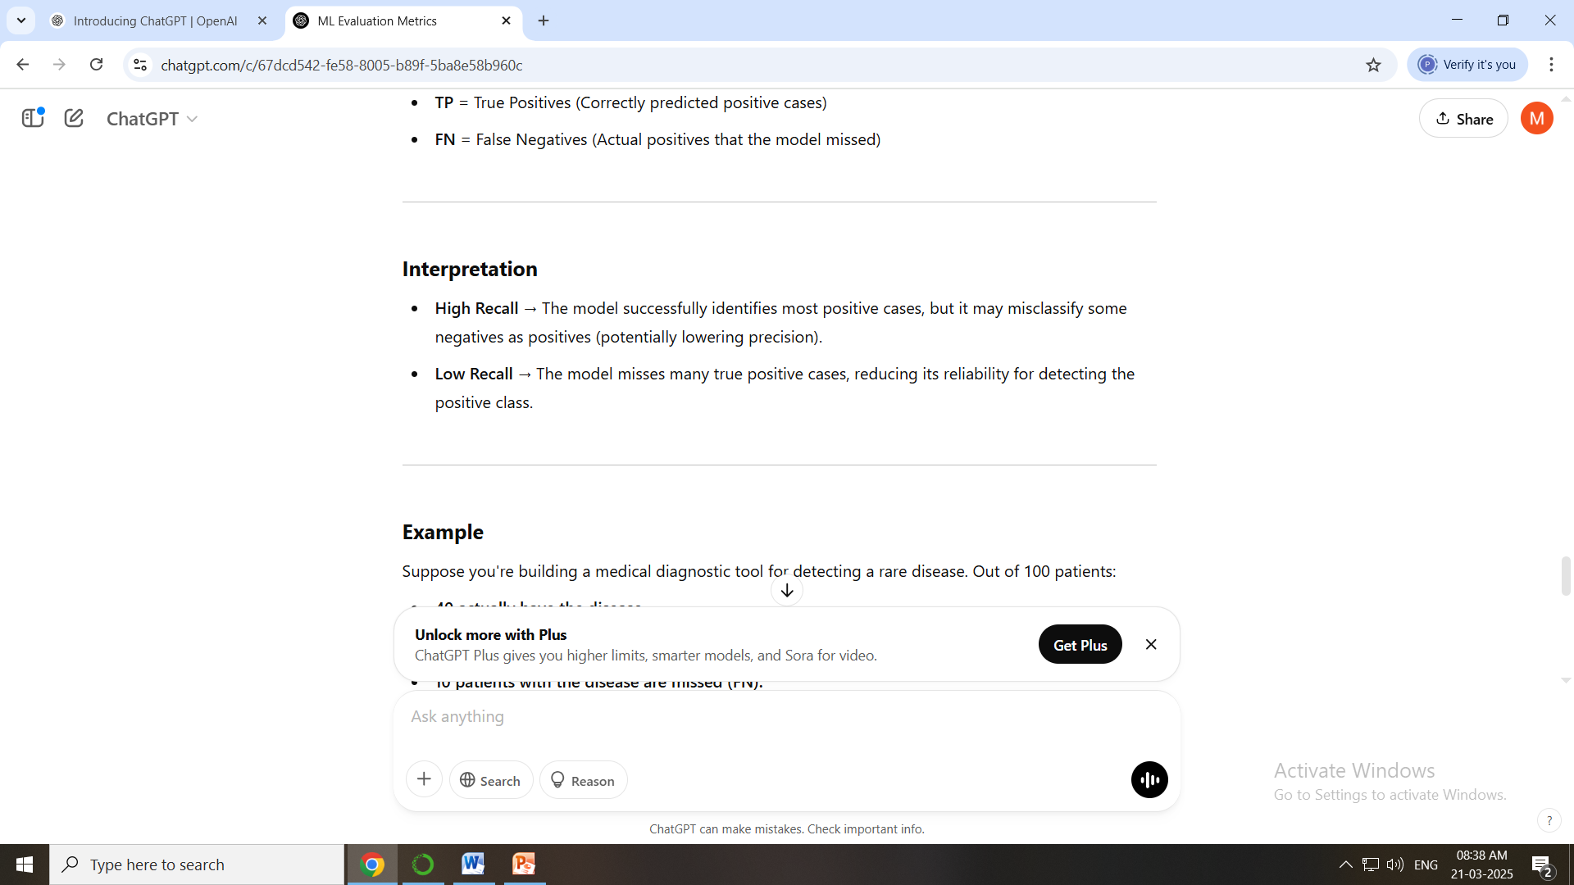
Recall (Sensitivity, True Positive Rate)
Recall is a classification metric that measures the proportion of actual positive instances that the model correctly identifies. It focuses on minimizing false negatives, ensuring the model captures as many true positives as possible.

Slide 5
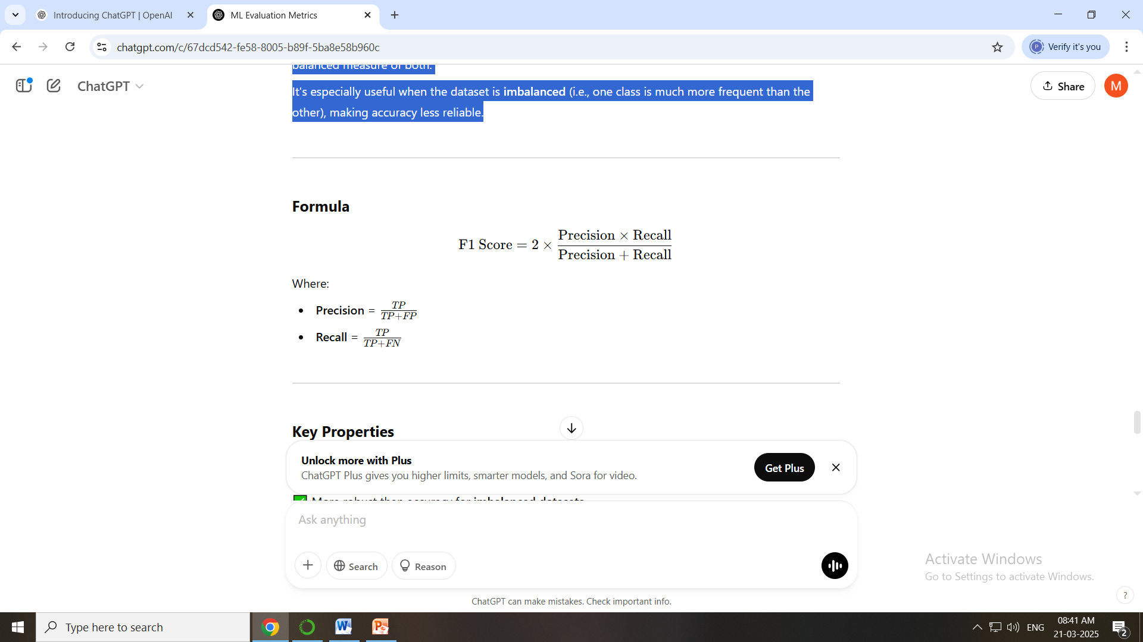
F1 Score (Harmonic Mean of Precision and Recall)
The F1 Score is a classification metric that combines Precision and Recall into a single value, providing a balanced measure of both.
It's especially useful when the dataset is imbalanced (i.e., one class is much more frequent than the other), making accuracy less reliable.

Slide 6
Precision vs Recall vs F1 Score
Metric | Best For | Trade-Off
Precision | Minimizing false positives | May sacrifice true positives
Recall | Minimizing false negatives | May increase false positives
F1 Score | Balancing Precision and Recall | Can be harder to interpret directly

Slide 7
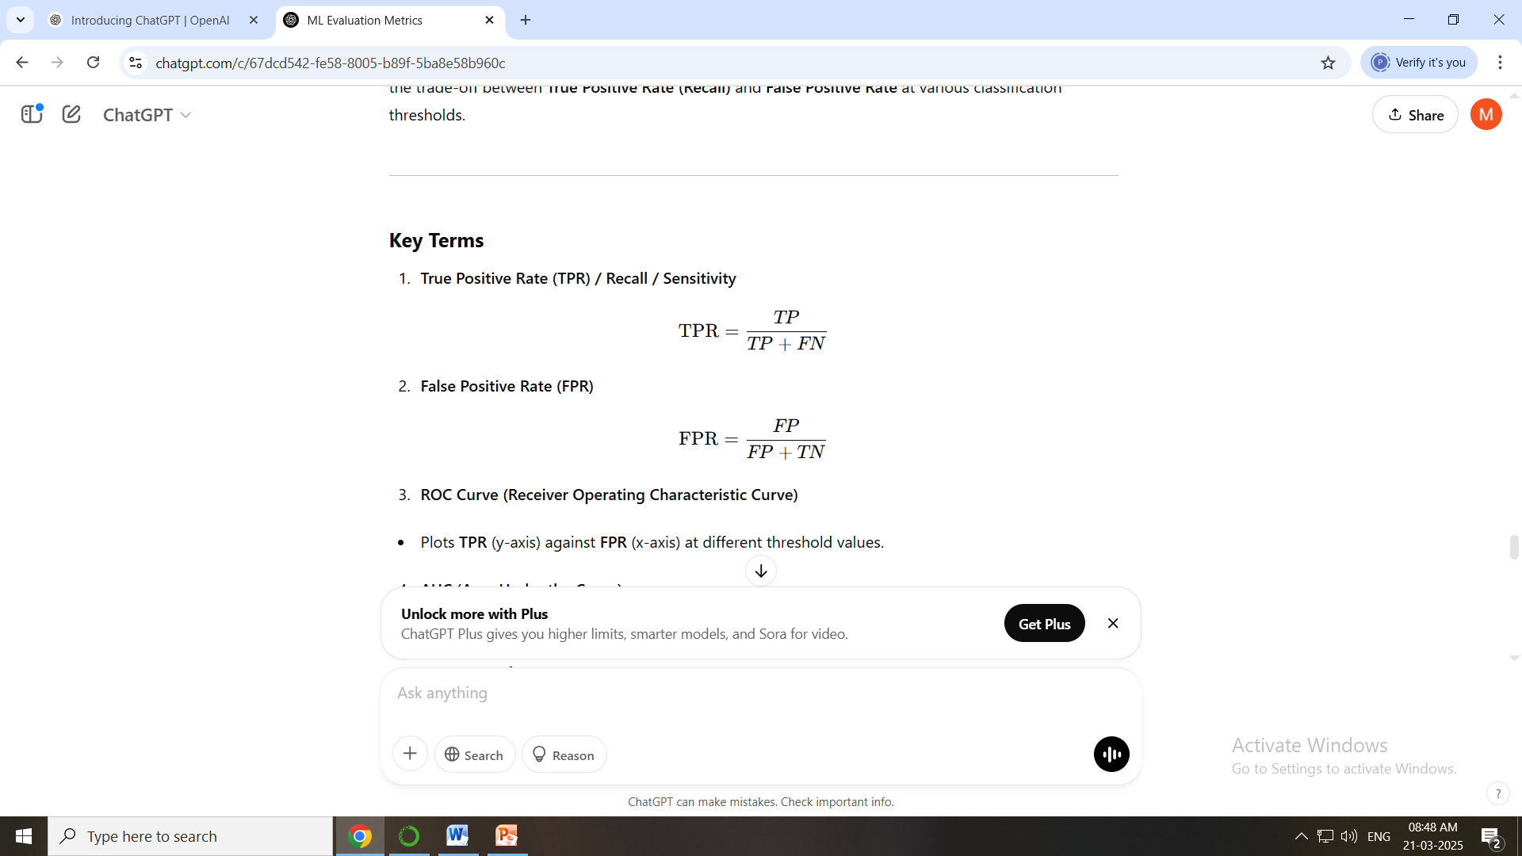
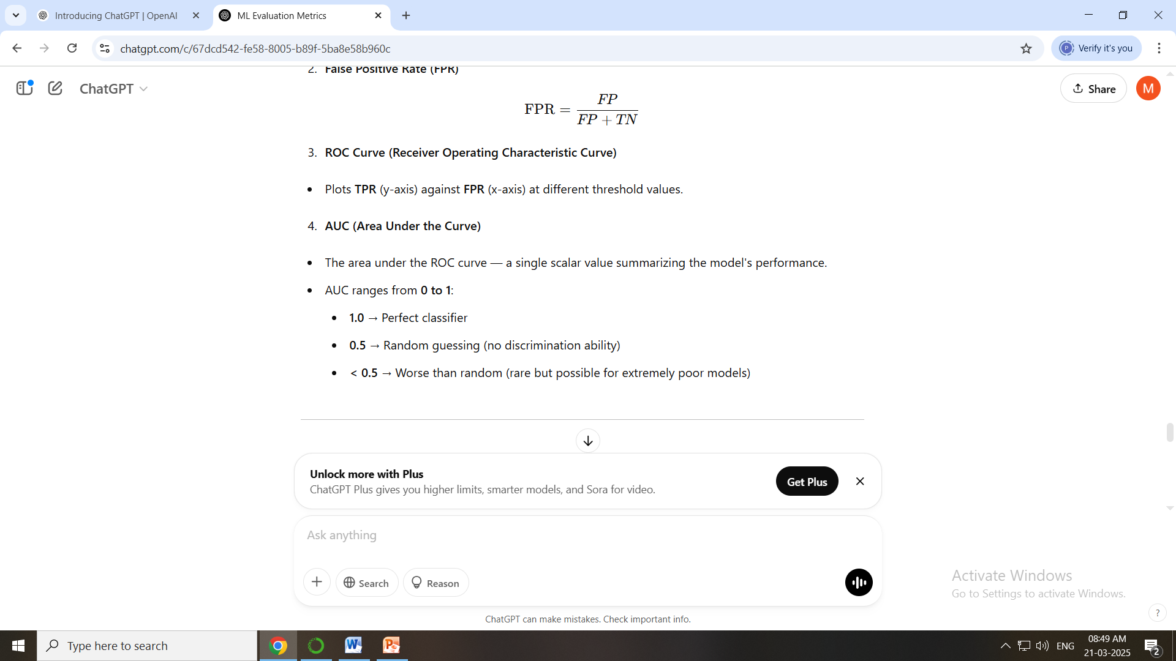
AUC-ROC (Area Under the Receiver Operating Characteristic Curve)
The AUC-ROC curve is a powerful evaluation metric used for binary classification models. It visualizes the trade-off between True Positive Rate (Recall) and False Positive Rate at various classification thresholds.

Slide 8
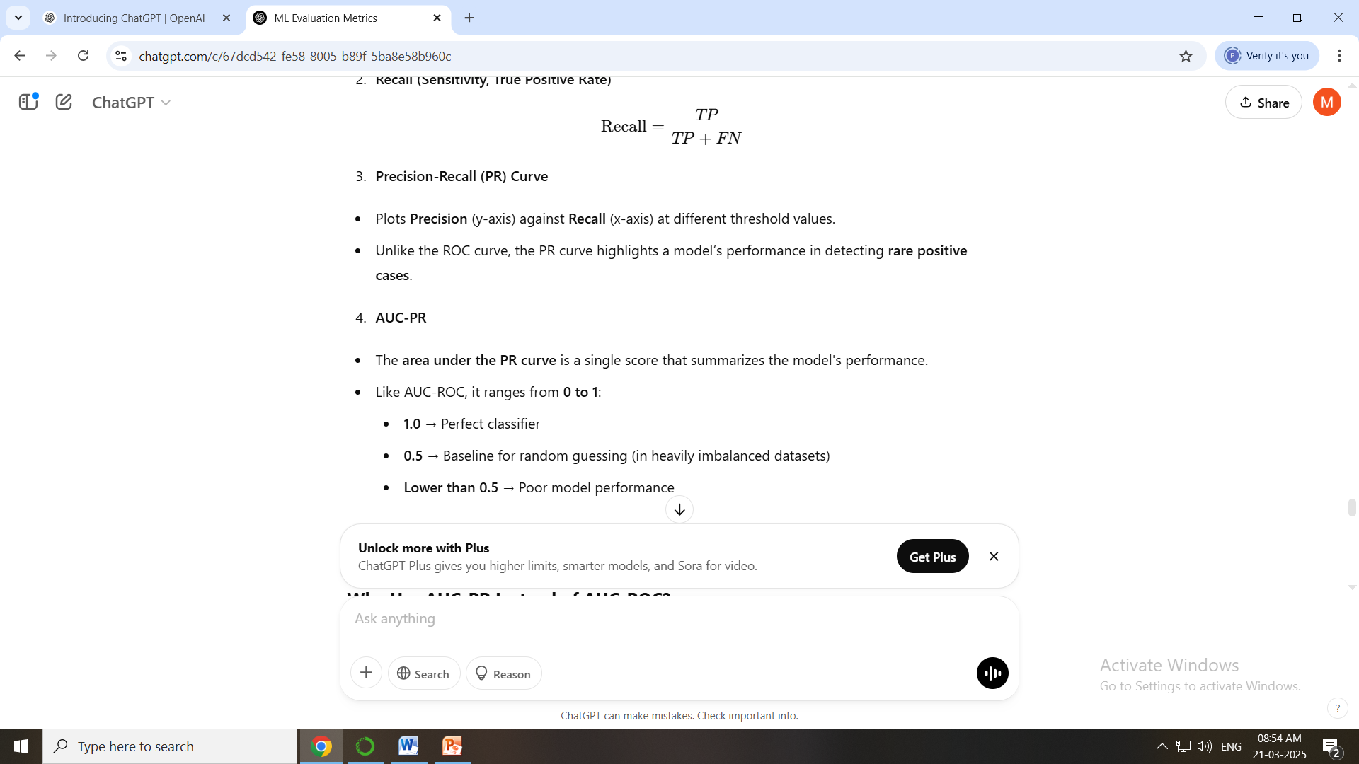
AUC-PR (Area Under the Precision-Recall Curve)
AUC-PR is a metric that evaluates the performance of binary classification models, particularly on imbalanced datasets. Unlike the AUC-ROC curve, which considers both positive and negative classes equally, AUC-PR focuses specifically on the model's ability to identify positive instances.

Slide 9
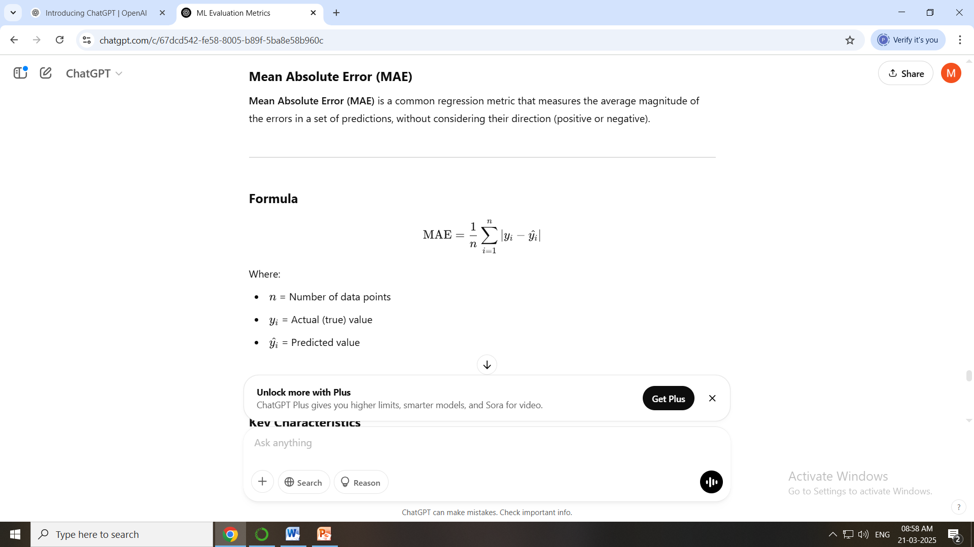
Regression Metrics:Mean Absolute Error (MAE)
Mean Absolute Error (MAE) is a common regression metric that measures the average magnitude of the errors in a set of predictions, without considering their direction (positive or negative).

Slide 10
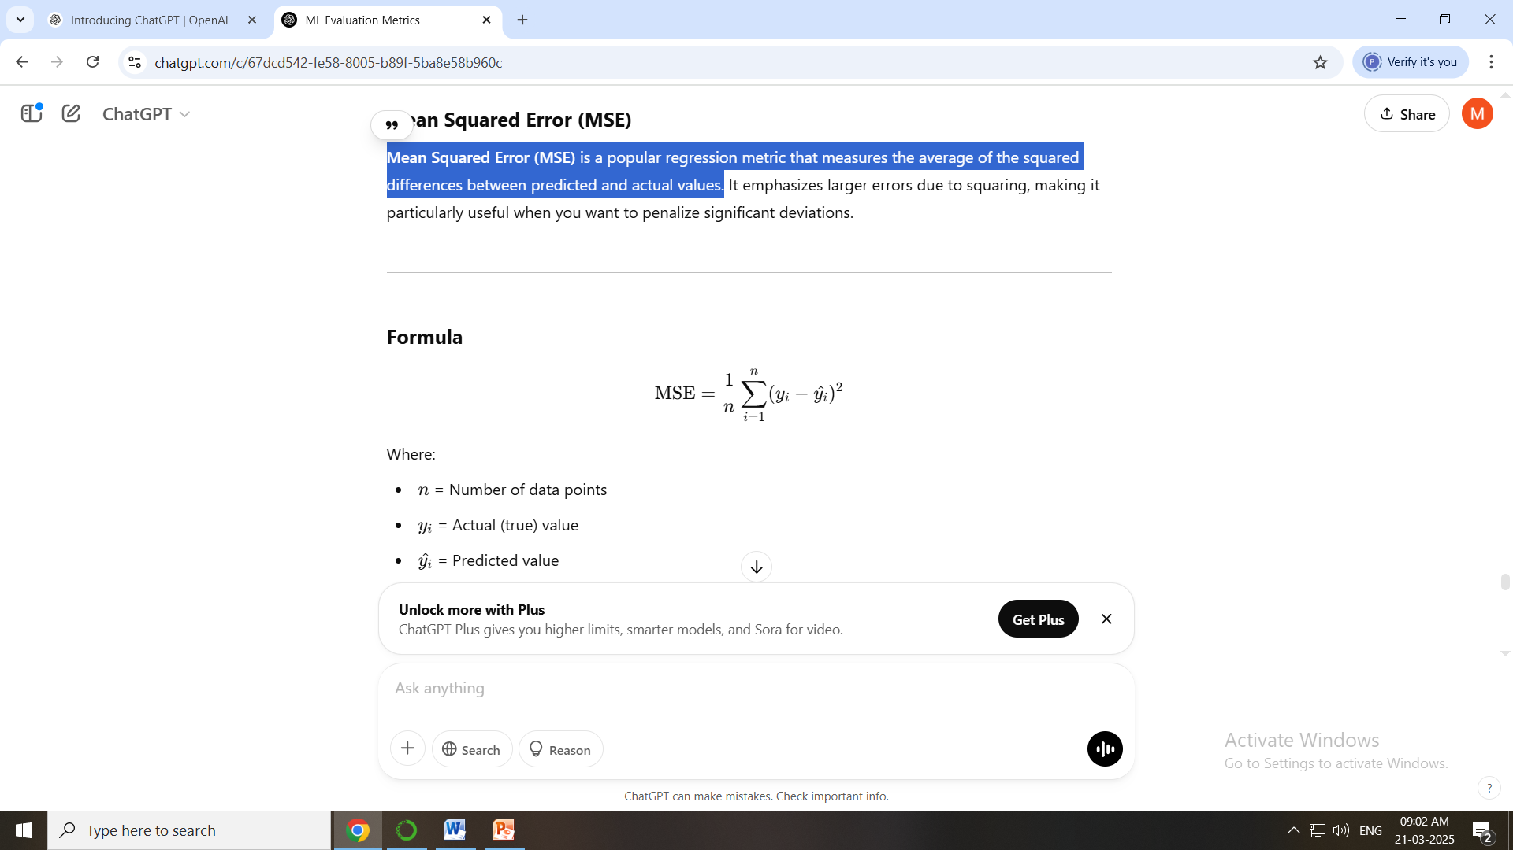
Mean Squared Error (MSE)
Mean Squared Error (MSE) is a popular regression metric that measures the average of the squared differences between predicted and actual values.

Slide 11
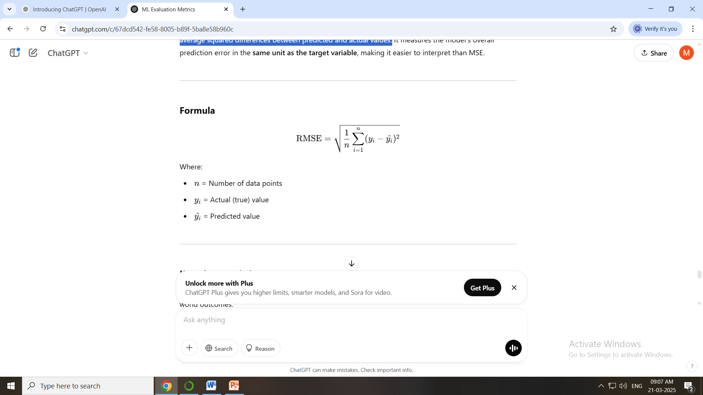
Root Mean Squared Error (RMSE)
Root Mean Squared Error (RMSE) is a popular regression metric that represents the square root of the average squared differences between predicted and actual values.

Slide 12
MAE vs MSE vs RMSE
Metric | Best Use Case | Outlier Sensitivity | Interpretation
MAE | Balanced data with evenly distributed errors | Less sensitive | Measures average error
MSE | Prioritizing large errors for penalty | More sensitive | Emphasizes larger errors
RMSE | Similar to MSE but easier to interpret | More sensitive | Same unit as the target variable

Slide 13
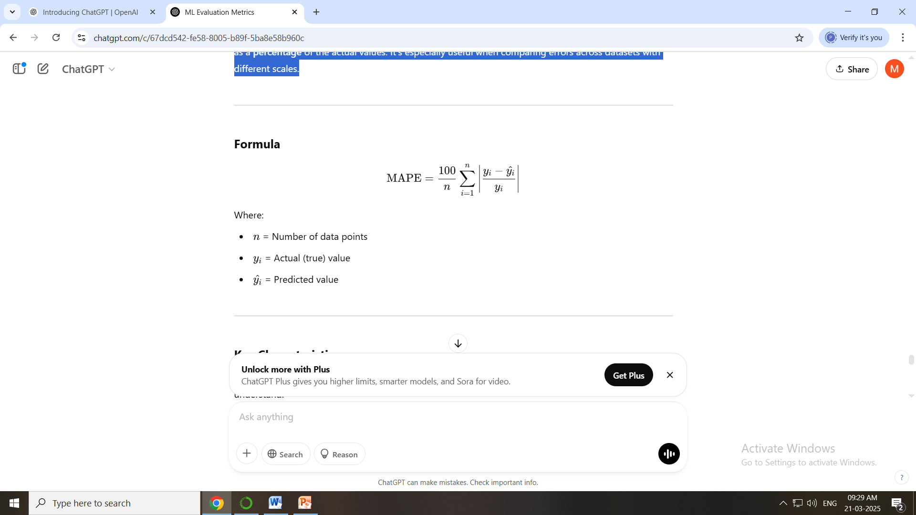
Mean Absolute Percentage Error (MAPE)
Mean Absolute Percentage Error (MAPE) is a popular regression metric that expresses prediction error as a percentage of the actual values. It's especially useful when comparing errors across datasets with different scales.

Slide 14
MAPE vs RMSE vs MAE
Metric | Best Use Case | Scale Sensitivity | Error Display
MAPE | Comparing models across datasets with different scales | Scale-invariant | Percentage error
RMSE | Penalizing large errors heavily | Scale-dependent | Same unit as the target
MAE | Balanced data with equally important errors | Scale-dependent | Absolute error value

Slide 15
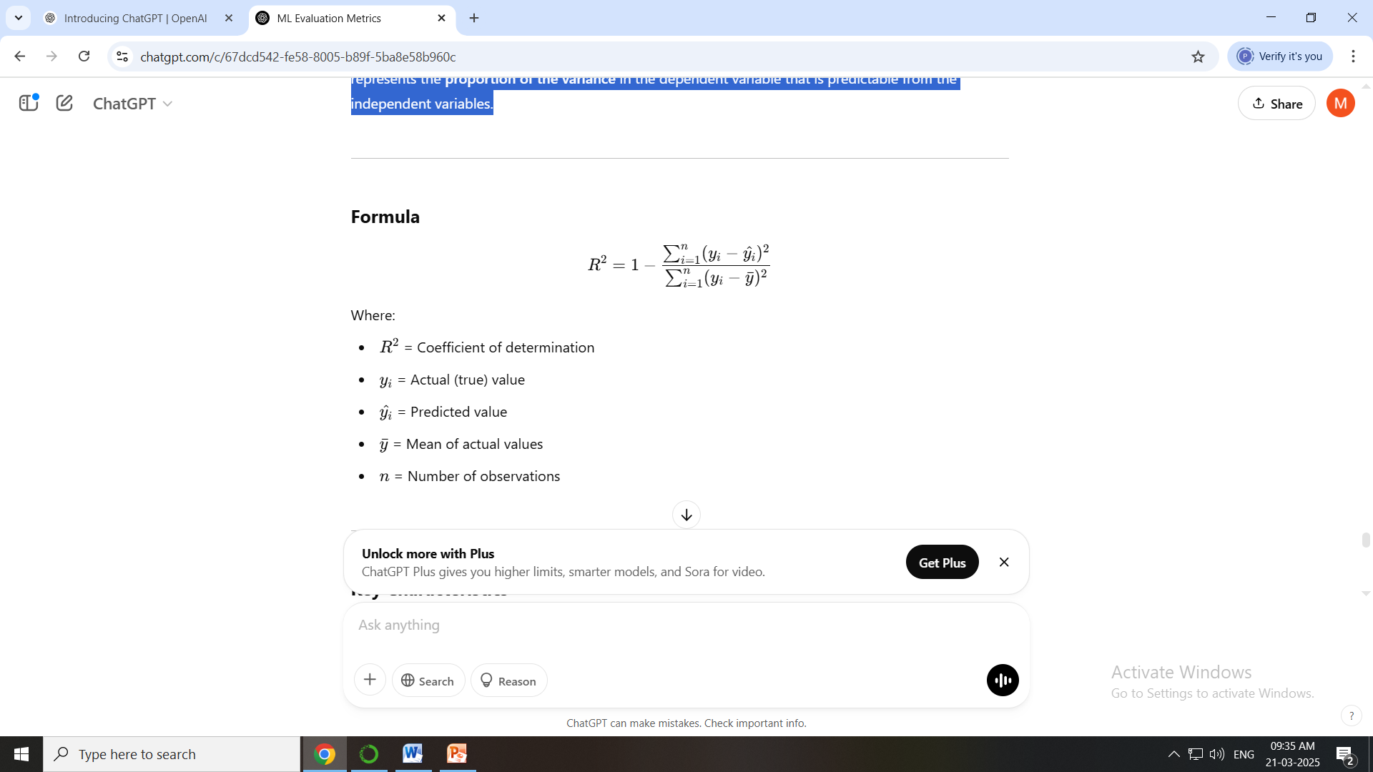
R-squared (R²) / Coefficient of Determination
R-squared (R²) is a statistical measure that indicates how well a regression model fits the data. It represents the proportion of the variance in the dependent variable that is predictable from the independent variables.

Slide 16
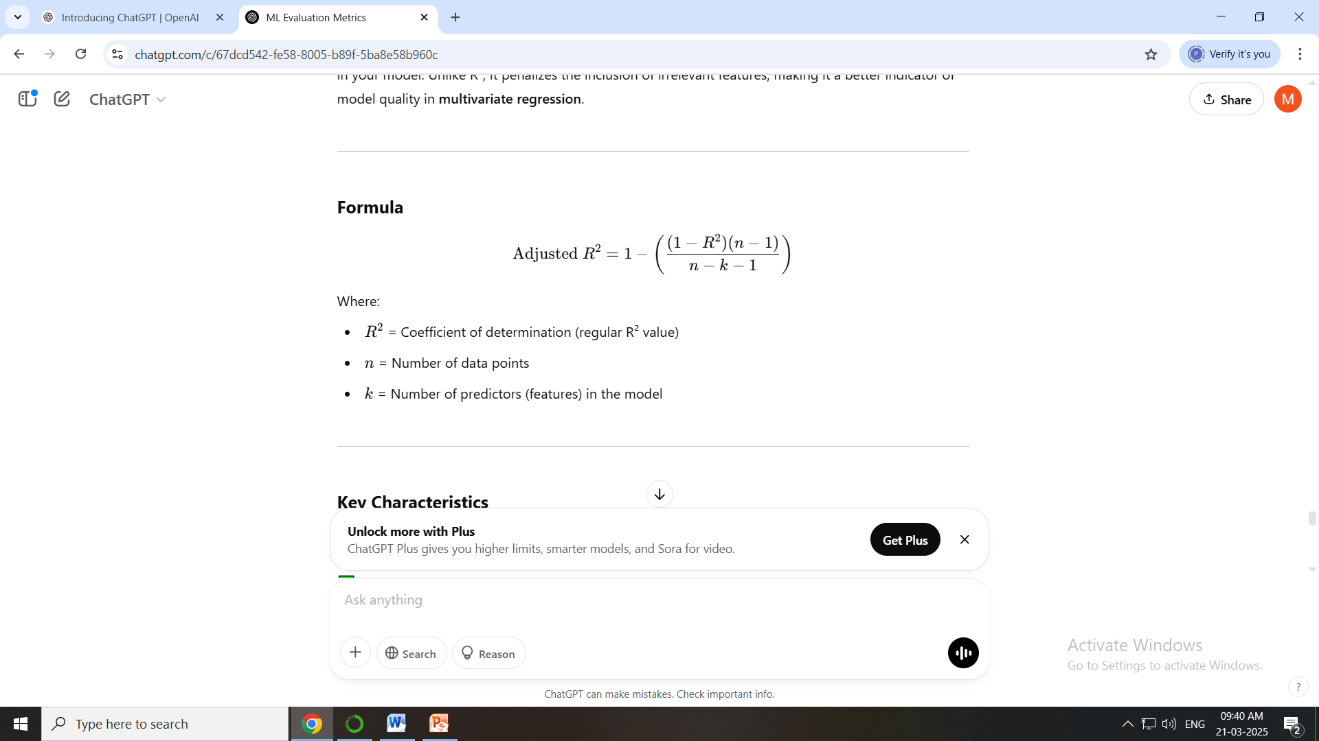
Adjusted R²
Adjusted R² is a modified version of R-squared (R²) that adjusts for the number of predictors (features) in your model. Unlike R², it penalizes the inclusion of irrelevant features, making it a better indicator of model quality in multivariate regression.

Slide 17
R² vs Adjusted R²
Metric | Purpose | Handles Complexity | Best Use Case
R² | Measures explained variance | No | Simple regression models
Adjusted R² | Penalizes excessive predictors | Yes | Complex models with multiple features

Slide 18

Median Absolute Error
Median Absolute Error (MedAE) is a robust regression metric that measures the median of the absolute differences between predicted and actual values. Unlike Mean Absolute Error (MAE), it is highly resistant to outliers, making it ideal for datasets with extreme values

Slide 19
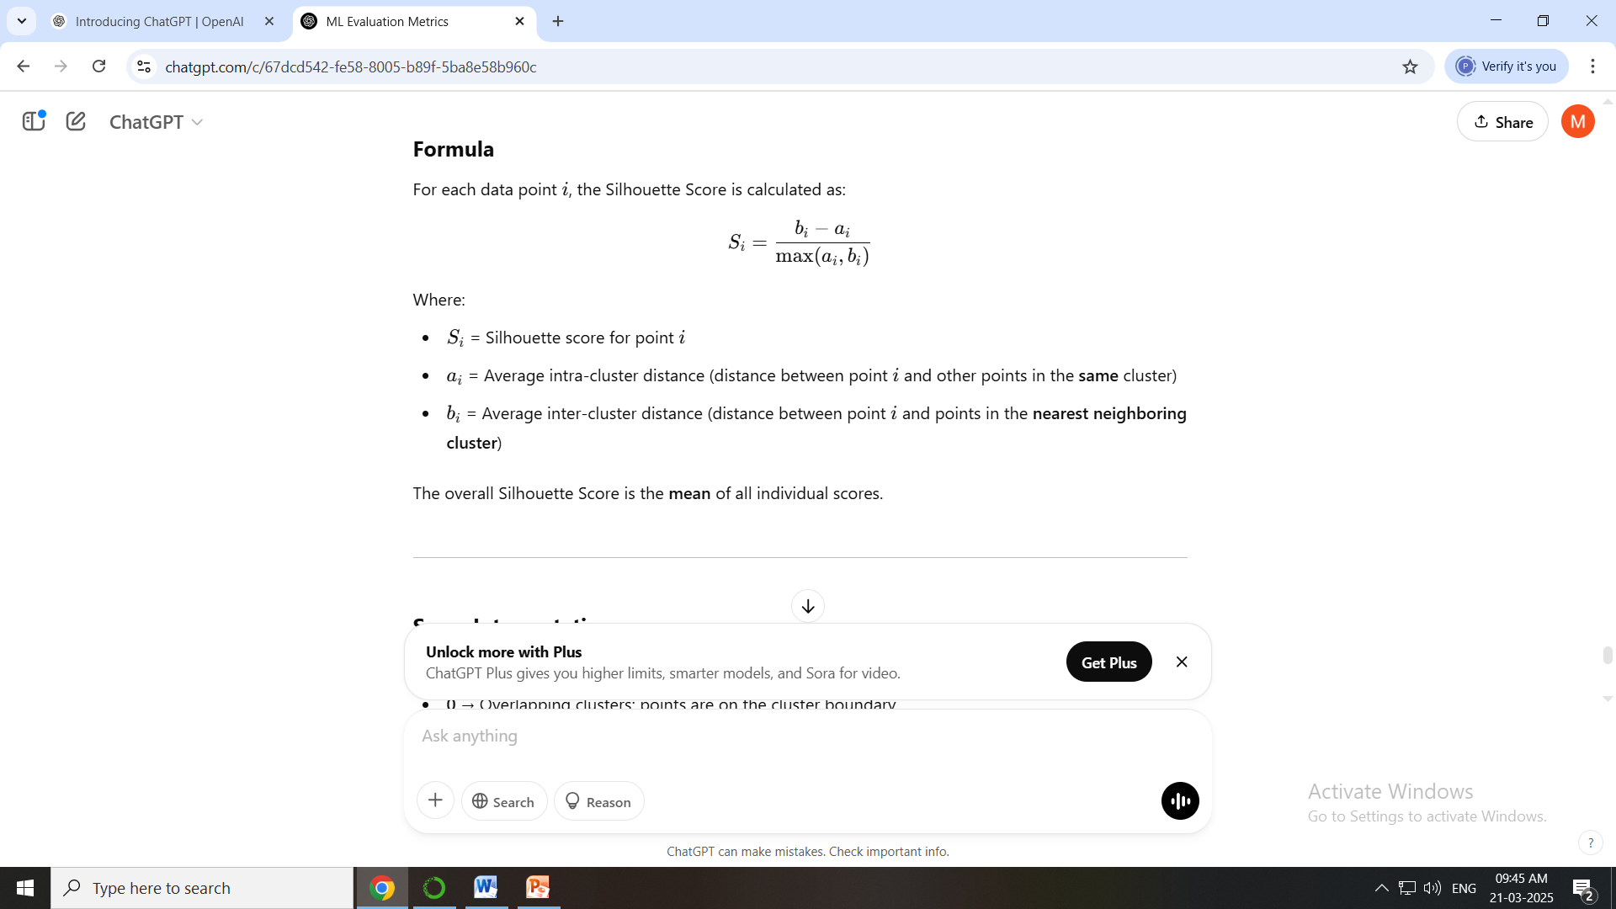
Clustering Metrics:Silhouette Score
It measures how similar each data point is to its own cluster (cohesion) compared to other clusters (separation). A higher Silhouette Score indicates that clusters are well-defined and distinctly separated.

Slide 20
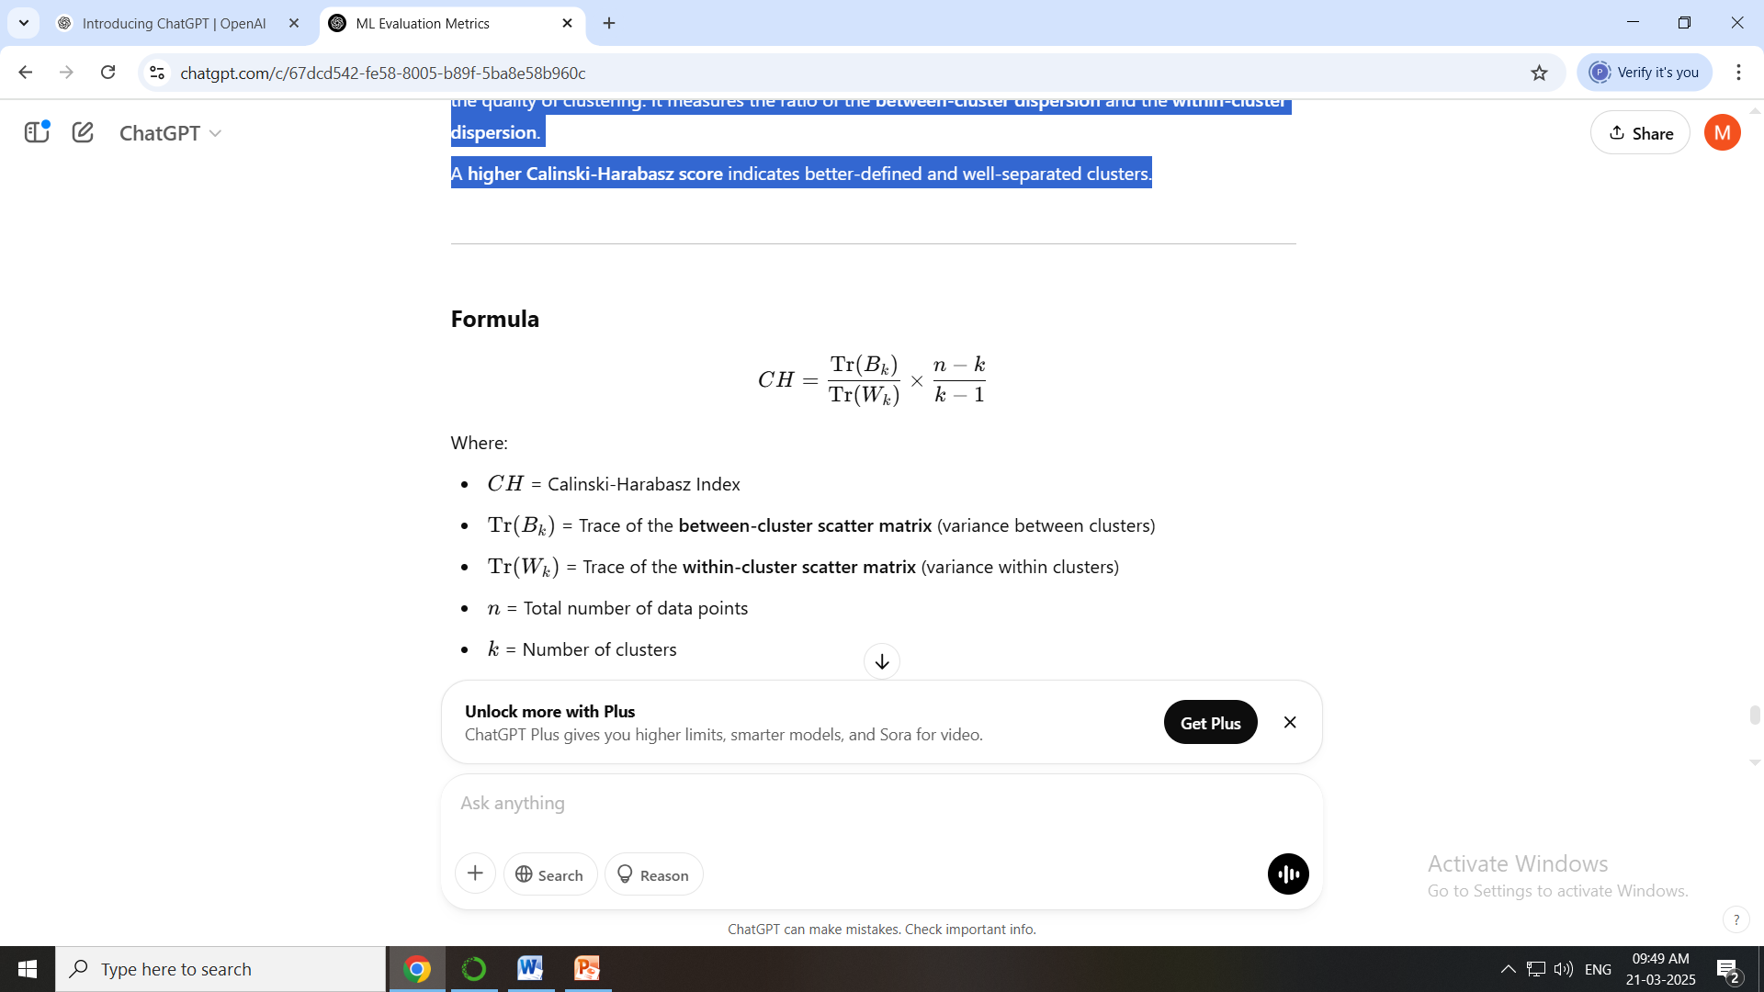
Calinski-Harabasz Index (Variance Ratio Criterion)
The Calinski-Harabasz Index (also known as the Variance Ratio Criterion) is a metric used to evaluate the quality of clustering. It measures the ratio of the between-cluster dispersion and the within-cluster dispersion.
A higher Calinski-Harabasz score indicates better-defined and well-separated clusters.

Slide 21
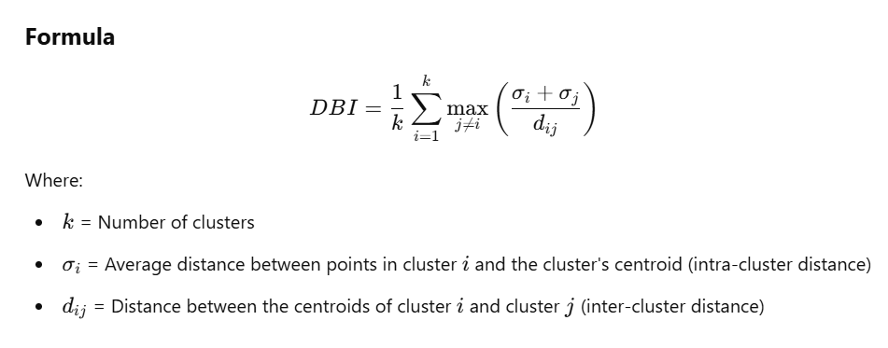
Davies-Bouldin Index (DBI)
The Davies-Bouldin Index is a clustering evaluation metric that assesses the compactness and separation of clusters. It quantifies how well-separated clusters are while ensuring that points within the same cluster remain closely packed.
✅ Lower DBI values indicate better clustering performance.

Slide 22
Adjusted Rand Index (ARI)
The Adjusted Rand Index (ARI) is a metric used to evaluate the similarity between two clustering results. It measures the agreement between the predicted cluster labels and the true labels (ground truth), adjusted for the chance of random grouping.
✅ ARI ranges from -1 to 1:
+1 → Perfect clustering (complete agreement with ground truth)
0 → Random clustering (no better than random chance)
< 0 → Worse than random clustering

Slide 23
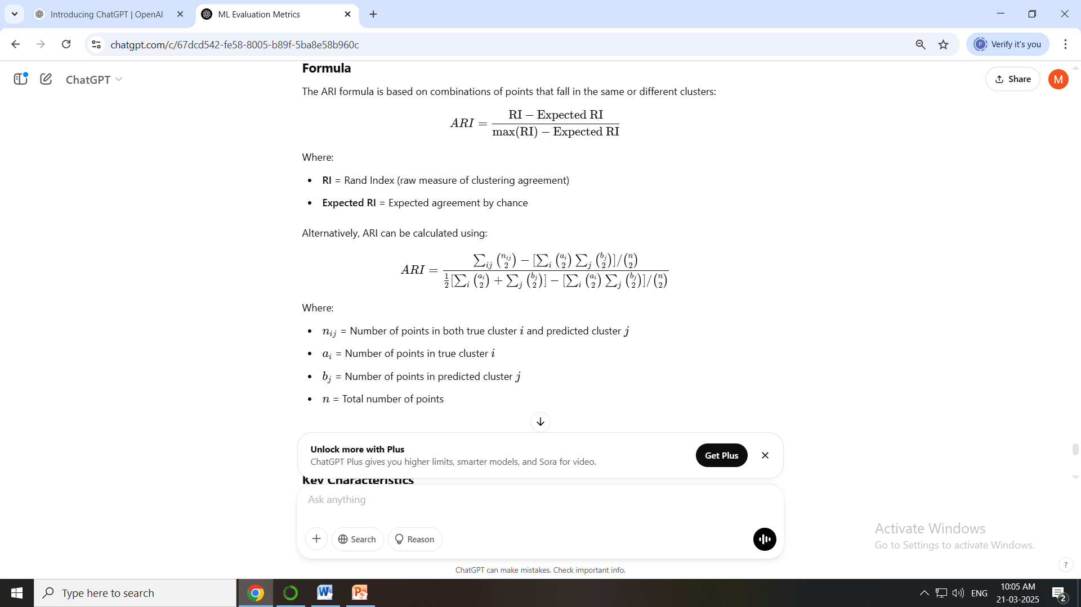

Slide 24
Fowlkes-Mallows Index (FMI)
The Fowlkes-Mallows Index (FMI) is a metric used to evaluate the similarity between two clusterings by comparing the true labels with predicted cluster assignments. It measures the precision and recall of the clustering.
✅ FMI ranges from 0 to 1:
1 → Perfect clustering (ideal agreement with ground truth)
0 → No similarity between the clusters

Slide 25
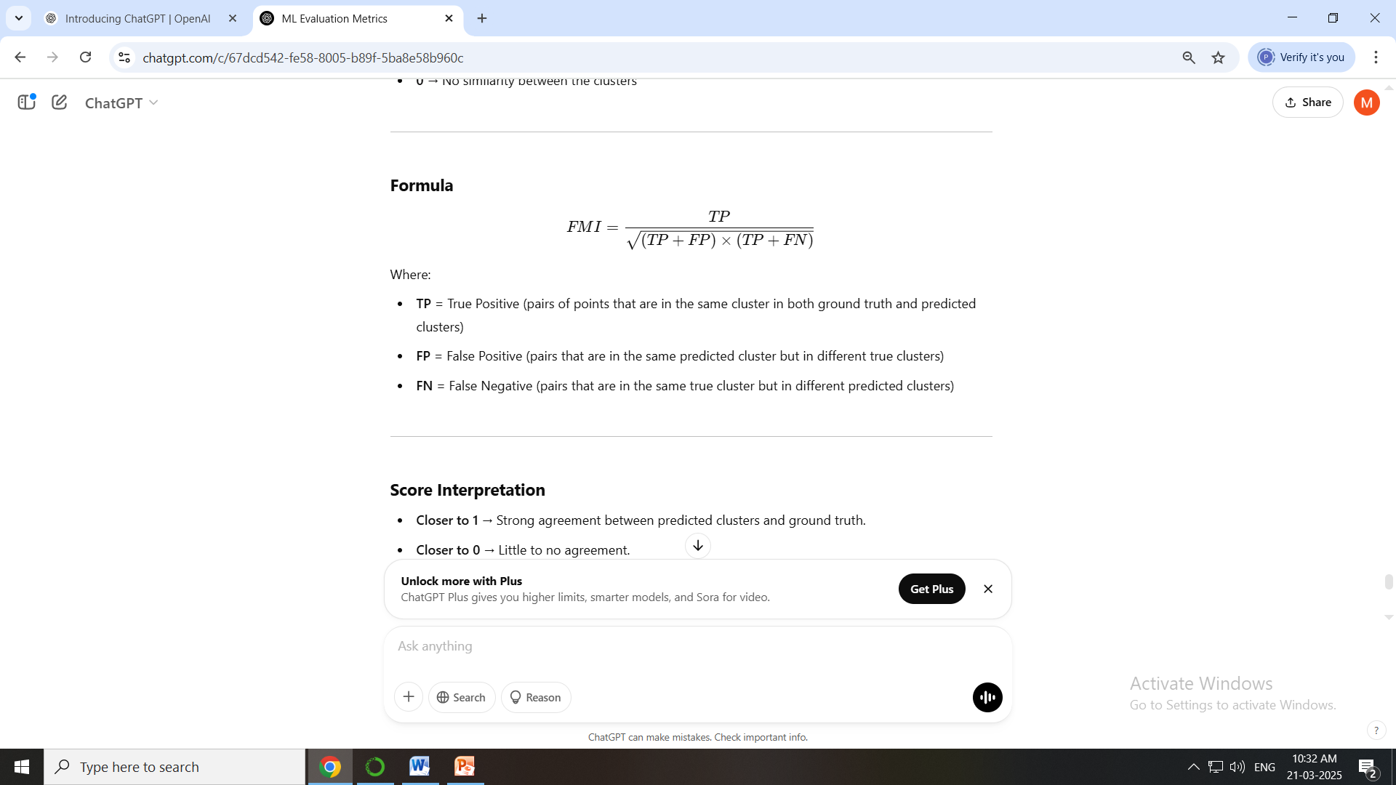


Slide 26
Normalized Mutual Information (NMI)
The Normalized Mutual Information (NMI) is a clustering evaluation metric that measures the mutual dependence between the predicted clusters and the true labels. It quantifies how much information the predicted clusters share with the ground truth.
✅ NMI ranges from 0 to 1:
1 → Perfect clustering (complete agreement with ground truth)
0 → No mutual information (completely random clustering)

Slide 27
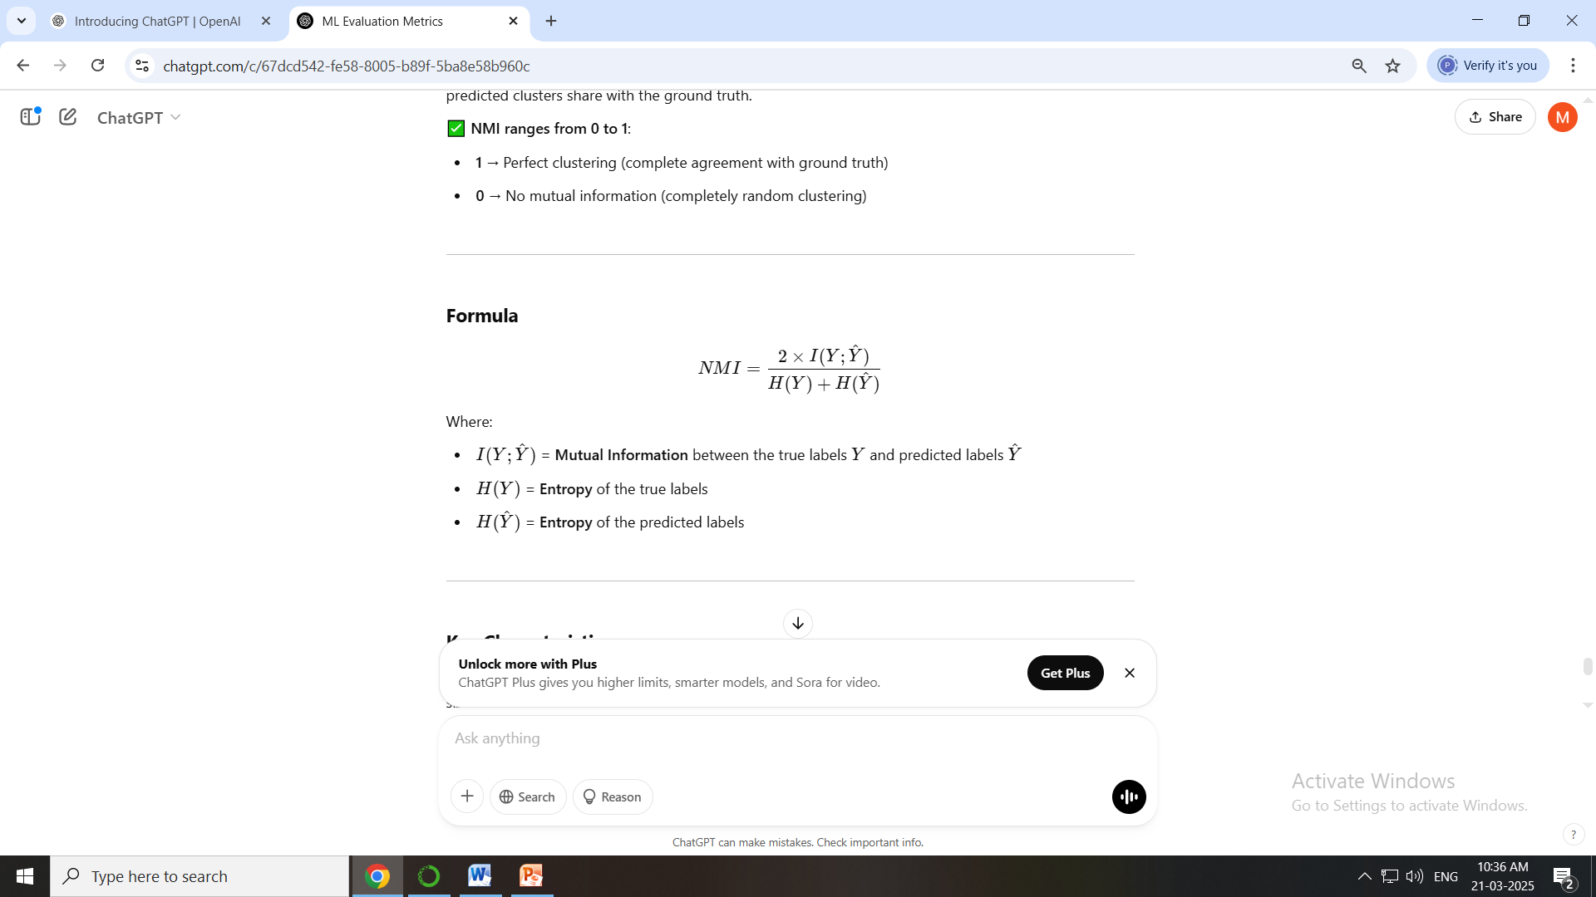

Slide 28
Metric | Type | Range | Optimal Value | Requires Ground Truth? | Handles Imbalanced Clusters? | Cluster Shape Sensitivity | Best For
Silhouette Score | Internal Metric | −1 to 1 | 1 (Best) | ❌ No | ❗ Limited | Prefers spherical clusters | Evaluating compactness & separation
Calinski-Harabasz Index | Internal Metric | ≥ 0 | Higher is better | ❌ No | ❗ Limited | Prefers convex clusters | Assessing variance ratio in clusters
Davies-Bouldin Index | Internal Metric | ≥ 0 | Lower is better | ❌ No | ❗ Limited | Prefers convex clusters | Measuring compactness & separation
Adjusted Rand Index (ARI) | External Metric | −1 to 1 | 1 (Perfect Agreement) | ✅ Yes | ✅ Strong | Flexible | Comparing predicted clusters to true labels
Normalized Mutual Information (NMI) | External Metric | 0 to 1 | 1 (Perfect Agreement) | ✅ Yes | ✅ Strong | Flexible | Evaluating mutual dependence between predicted and true clusters
Fowlkes-Mallows Index (FMI) | External Metric | 0 to 1 | 1 (Perfect Clustering) | ✅ Yes | ✅ Strong | Flexible | Assessing precision-recall balance in clusters

